Slide 1
Bike Dekho – Bike Sales Analysis
Excel Data Analytics Project
Tools: Microsoft Excel
Prepared by: Binjal Patel

Slide 2
Project Overview
Hands-on Excel project analyzing bike sales trends.
Focus on data cleaning, EDA, visualization & dashboarding.
To uncover key patterns in customer demographics, bike preferences, and sales performance.
To create an interactive and insightful dashboard for decision-makers.

Slide 3
Project Objectives
Clean and organize raw sales data
Perform EDA using Excel
Identify customer & sales patterns
Build an interactive dashboard

Slide 4
Data Cleaning & Preprocessing
Removed duplicates & handled missing values
Standardized date, currency & text formats
Created calculated columns (Age, Profit, Margin)

Slide 5
Exploratory Data Analysis
Sales by gender, region, category
Bike preference by demographics
Income & occupation impact
Functions used: SUMIFS, COUNTIFS, IF, VLOOKUP

Slide 6
Dashboard Highlights
KPIs: Total Sales, Units Sold, Avg Income
Segmentation by region & gender
Clean executive-style layout

Slide 7
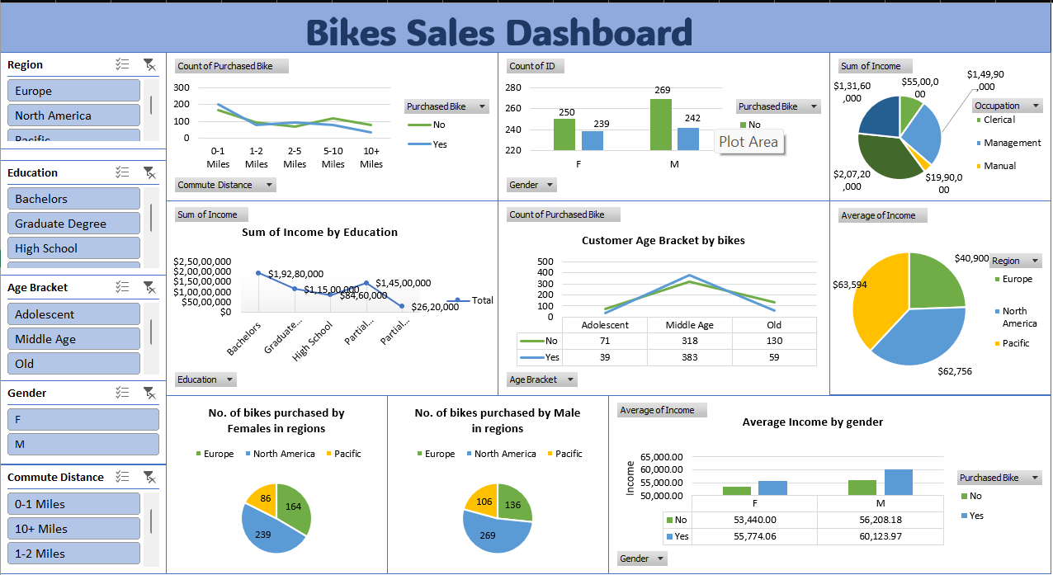

Slide 8
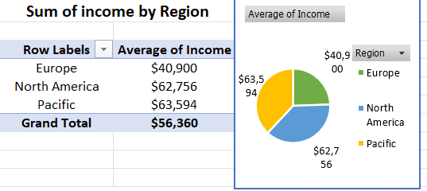
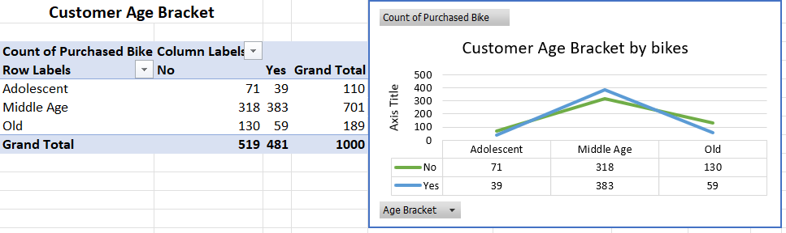
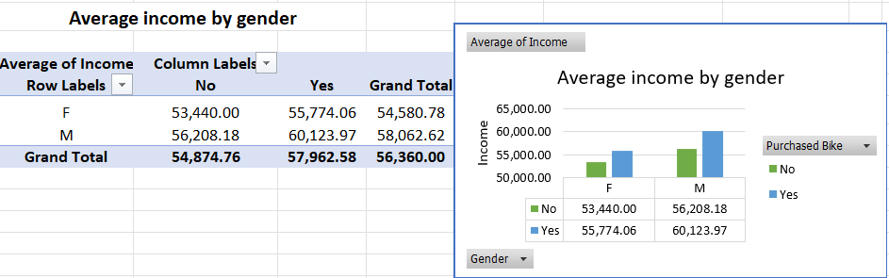
Key Visuals from Excel Dashboard

Slide 9
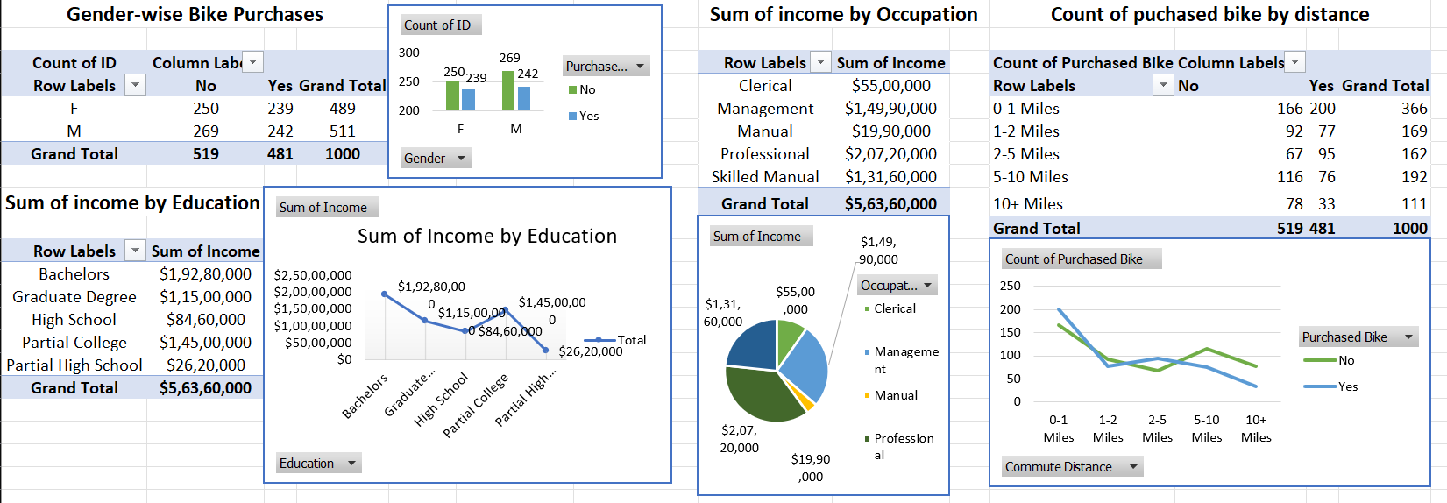

Slide 10
Key Business Insights
Married males (30–45) are top buyers
Mountain bikes most popular
Western region leads sales
Income strongly affects buying behavior

Slide 11
Conclusion
This project showcases Excel as a powerful BI tool
for business-driven decision making.

